Slide 1

Reinforcement learning Based System For Support Of Cab Drivers
Under The Advice of
VAHID BEHZADAN (Assistant Professor)
Team Members
Chakra Mohan Kumar Kota -00772335
Krishna Rao Kundeti - 00772572

Slide 2

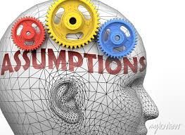

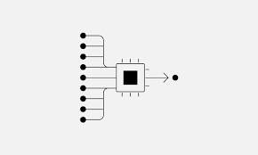

Table of Contents
Project Objectives
Assumptions
Approach
Output
Evaluation

Slide 3
Project Objective
Our main goal of this project is to build and RL based algorithms which can help the cab drivers to boost their yield by improving the agent’s decision-making process or having discussion with the agent’s.
Rl based system is for helping the cab drivers and they can potentially maintain and attract the new cab drivers.

Slide 4
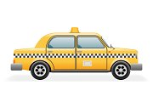


Assumptions
Cabs might be Electric or Gas that can run up to their miles for approximately 20 days
Cabs can operate with multiple locations across the city
All the decisions will be made at every hour intervals
The time taken to travel from one place to another place is considered in integer only

Slide 5
Approach
In this project an environment and an Rl agent will be created that learns to be choose the request.
Agent will be trained using MDP.
Tolls and Technologies that are used for this project
Deep Q learning
Python packages like Numpy
Matplotlib
JupyterNotebook
Tensorflow
Keras
Pytorch

Slide 6
Delivarables:
Env.py is the Environment class, Each method (function) of the class will have a specific purpose.
If we can generate random number of requests, we can calculate the time duration for their destinations and rewards for next ride
Build an agent that learns to pick the best request using DQN
Need to calculate the target Q value for each example
Must update the output and Input Q values
Agent training DQL

Slide 7
Evaluation
This Model Continuously will update the strategies to learn a strategy that will maximize long-term increasing rewards.
Below are the matrices for this model
Q value convergence
Rewards that get per episode

Slide 8
THANK YOU

